Slide 1

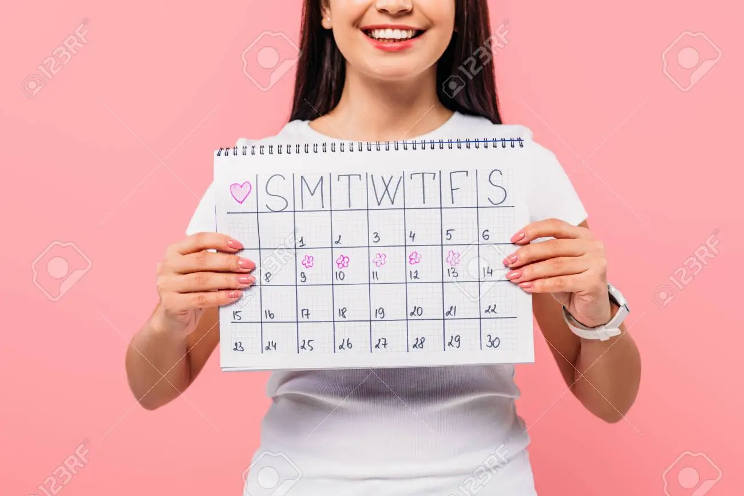
MY Period Tracker

Slide 2

Menstruation
Menstruation, or period,is normal vaginal bleeding that occurs as part of a woman’s monthly cycle.
Every month your body prepares for pregnancy.
If no pregnancy occurs, the uterus,or womb,sheds its lining.
Period can last for about 5 days.
This occurs after every 28 days.

Slide 3


My Period Tracker
My Period Tracker allow women to track their menstrual cycles and receive a prediction for their period dates.

Slide 4

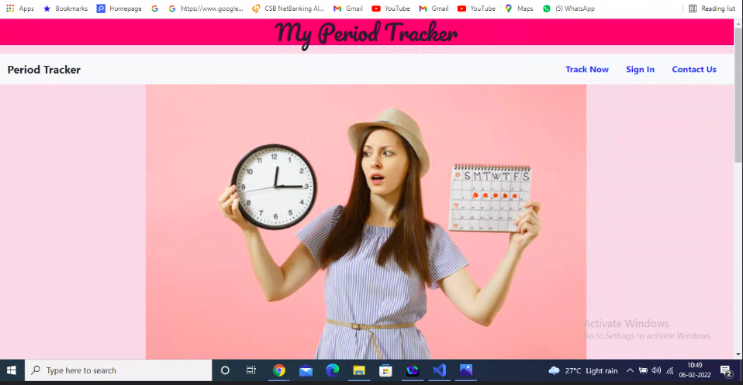
My Period Tracker

Slide 5

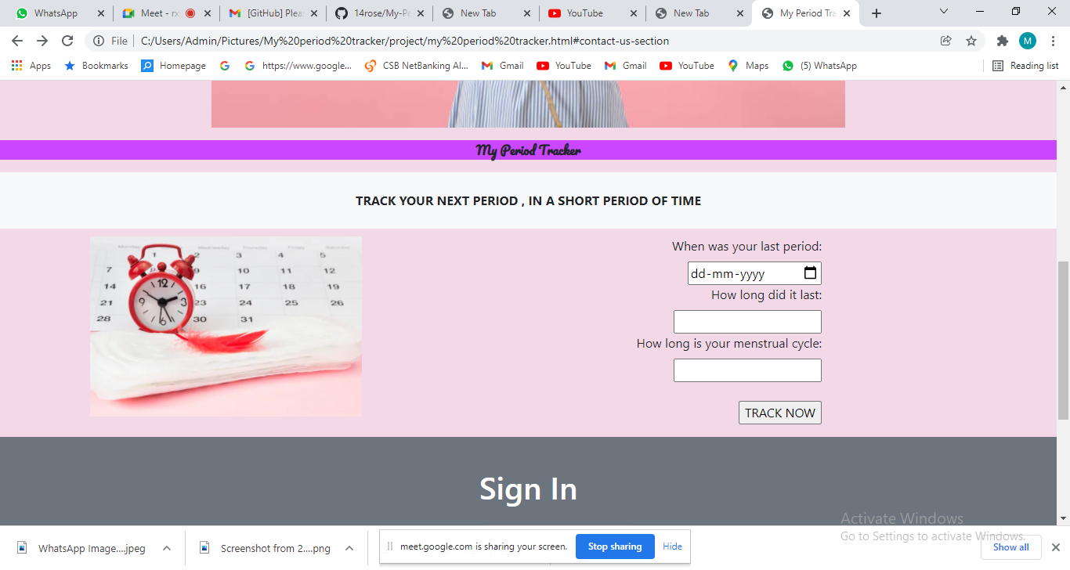

Slide 6

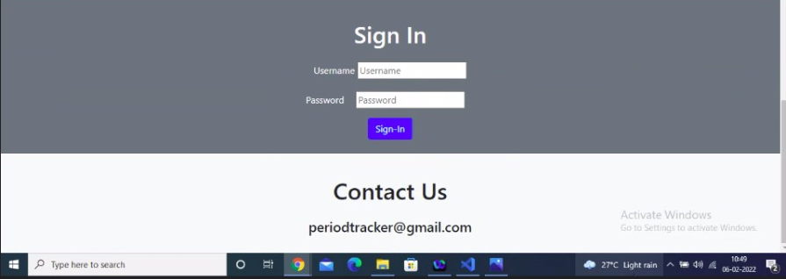

Slide 7

Benefits Of Period Tracking
It helps to track your next period.
It can help you understand your unique patterns.
It will increase your awareness of your overall health and wellness.
You can understand and manage your mood.
It’s a great way to get health updates.

Slide 8

Thank you

